Slide 1

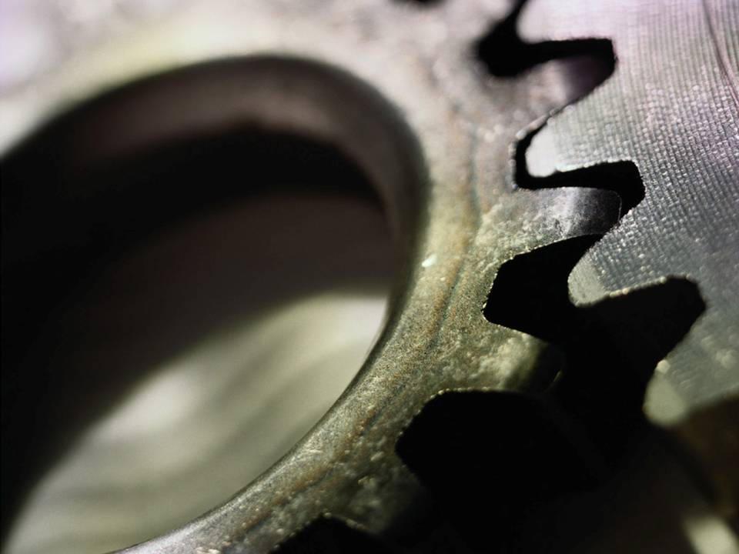
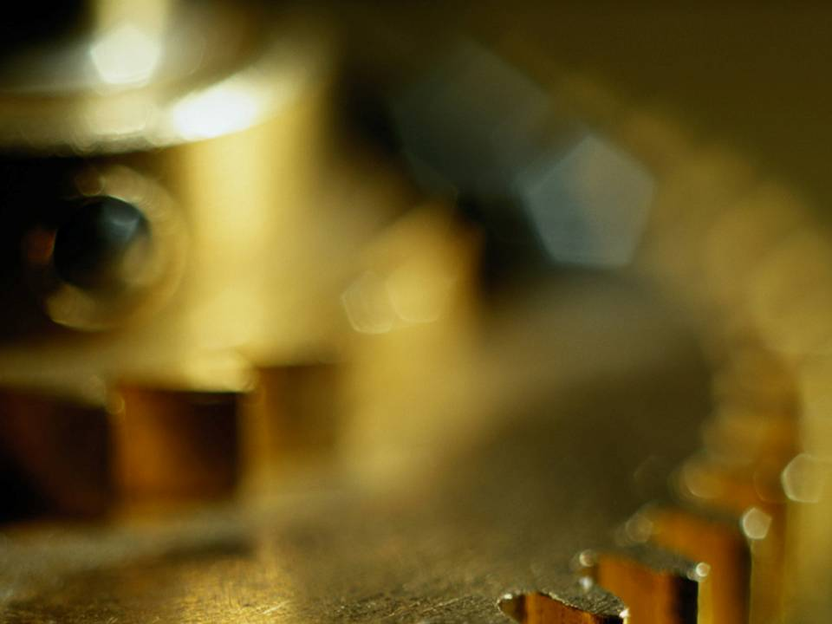
Chapter 12
Working Drawing

Slide 2
TOPICS
Introduction
Detail drawing
Assembly drawing
Assembly section
Dimensioning

Slide 3
Introduction

Slide 4
DEFINITION
Working drawing is a set of drawing used
during the work of making a product.
Working drawing
Detail
drawing
Assembly
drawing

Slide 5
DEFINITION
Detail drawing is a multiview representation of a single part with dimensions and notes.
Assembly drawing is a drawing of various
parts of a machine or structure assembled in their relative working positions.

Slide 6
PURPOSE
Detail drawing conveys the information and instructions for manufacturing the part.
Assembly drawing conveys
1. completed shape of the product.
2. overall dimensions.
3. relative position of each part.
4. functional relationship among various
components.

Slide 7
Detail Drawing

Slide 8
INFORMATION IN
DETAIL DRAWING
1. General information
Title block
2. Part’ s information
2.1 Shape description
Object’s
views
2.2 Size description
2.3 Specifications
Notes

Slide 9
GENERAL INFORMATION
Name of company
Title of drawing (usually part’s name)
Drawing sheet number
Name of drafter, checker
Relevant dates of action
(drawn, checked, approved etc.)
Revision table
Unit
Scale
Method of projection

Slide 10
PART’ S INFORMATION
Shape
Orthographic drawing
Pictorial drawing
Size
Dimensions and Tolerances
Specifications
Part number, name,
number required
Type of material used
General notes
Heat treatment
Surface finish
General tolerances

Slide 11
RECOMMENDED PRACTICE
Draw one part to one sheet of paper.
If not the case,
- apply enough spacing between parts.
- draw all parts using the same scale.
Otherwise, the scale should be clearly note
under each part’s drawing.
Standard parts such as bolt, nut, pin, bearing
do not require detail drawings.

Slide 12
PLACING AN INFORMATION
(This course)
Completed dimension
orthographic drawing
Part No., Part name, material, Number required
Notes
Title block
Unit, fillets & rounds sizes etc.

Slide 13
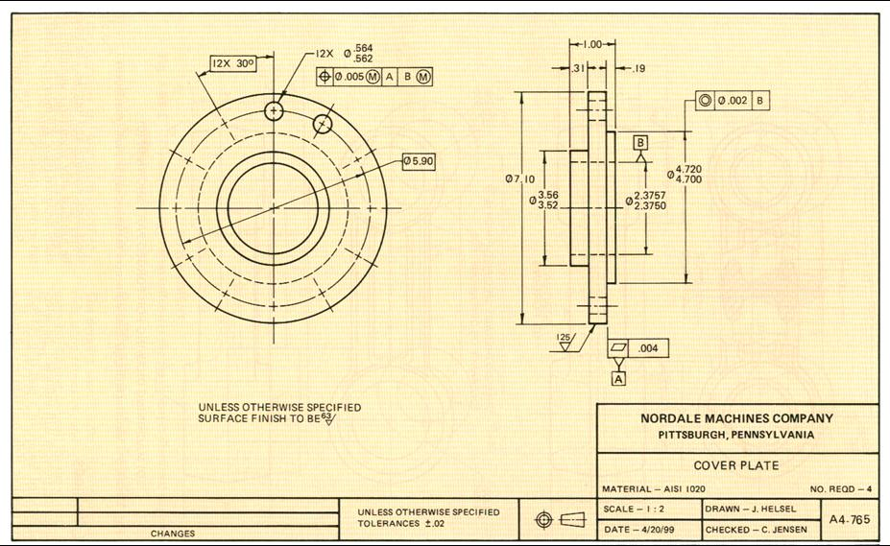
EXAMPLE : Interpreting detail drawing
1. Orthographic
views
2. Dimensions
& Tolerances
3. Surface
finishing
Title block
General note
Gen. tolerance
Projection
Revision table

Slide 14
Assembly Drawing

Slide 15
TYPES OF ASSEMBLY DRAWING
1. Exploded assembly drawings
The parts are separately display, but they are aligned according to their assembly positions and sequences.
2. General assembly drawings.
All parts are drawn in their working position.
3. Detail assembly drawings
All parts are drawn in their working position with a
completed dimensions.

Slide 16
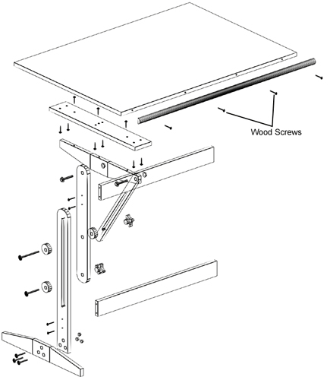
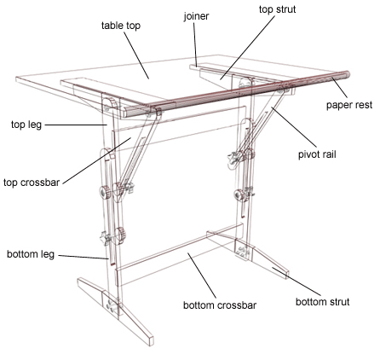
1. EXPLODED ASSEMBLY
Pictorial representation
Finished product

Slide 17
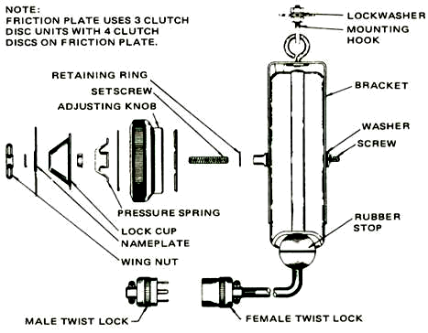
1. EXPLODED ASSEMBLY
Orthographic representation

Slide 18
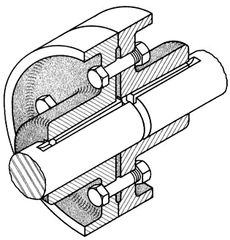
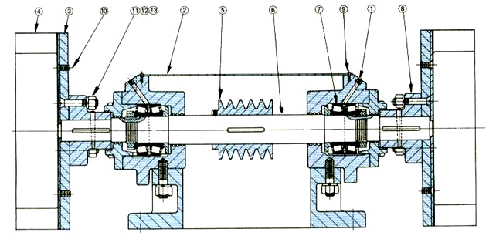
2. GENERAL ASSEMBLY
Pictorial
Orthographic

Slide 19
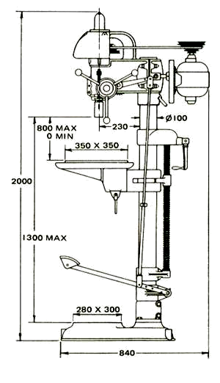
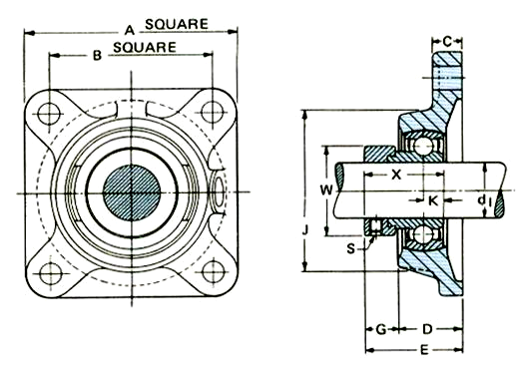
2. GENERAL ASSEMBLY
Only dimensions relate to machine’s operation are given.
Only dimensions relate to machine’s operation are given
in tabulated form (not shown).

Slide 20
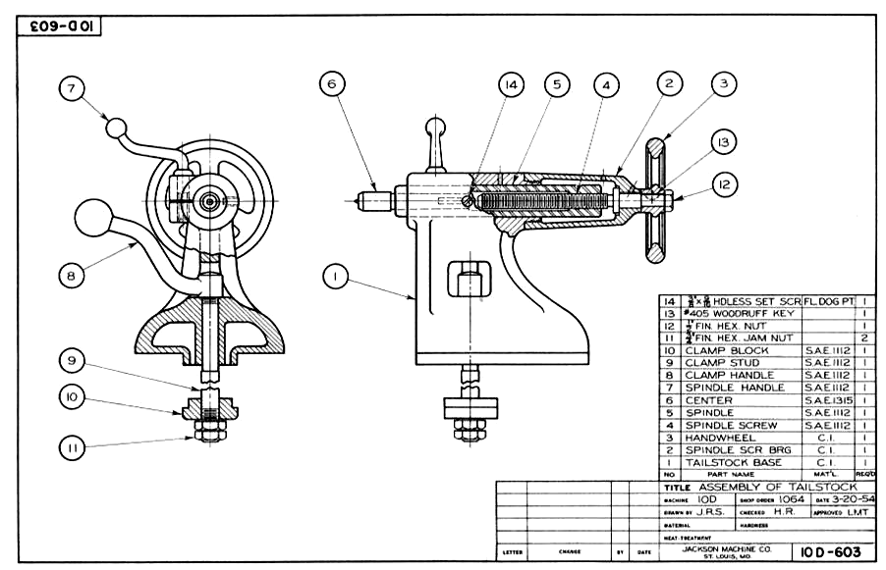
2. GENERAL ASSEMBLY

Slide 21
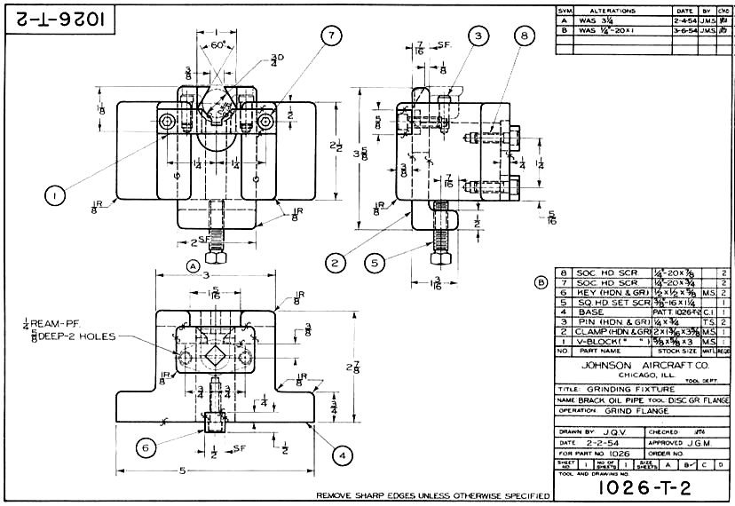
3. DETAILED ASSEMBLY
(working-drawing assembly)

Slide 22
REQUIRED INFORMATION IN
GENERAL ASSEMBLY DRAWING
1. All parts, drawn in their operating position.
2. Part list (or bill of materials, BOM)
Item number
Descriptive name
Material, MATL.
Quantity required (per a unit of machine), QTY.
3. Leader lines with balloons around part numbers.
4. Machining and assembly operations and critical
dimensions related to operation of the machine.

Slide 23
PLACING AN INFORMATION
(This course)
- Assembled parts
- Reference numbers
Part list
General notes
Title block

Slide 24
PART LIST (BOM) (This course)
Locate above or beside the title block.
Fill the table from the bottom.
Stainless Steel,
M3 HEX SOCK CUP PT
3
SET SCREW
1
2
SHAFT
1
Stainless Steel
1
SUPPORT
2
Cast Iron
NO.
PART NAME
REQD.
MATL. & NOTE

Slide 25
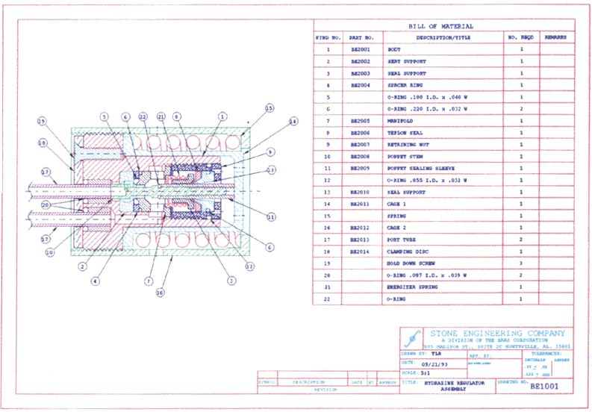
EXAMPLE : Another allowable place for BOM

Slide 26
STEPS TO CREATE
ASSEMBLY DRAWING
1. Analyze geometry and dimensions of all parts
in order to understand the assembly steps and
overall shape of device or machine.
2. Select an appropriate view.
3. Choose major parts, i.e. parts that have
several parts assembled on.
4. Draw a view of major parts according to a
selected viewing direction.

Slide 27
STEPS TO CREATE
ASSEMBLY DRAWING
5. Add detail view of the remaining parts at their
working positions.
6. Apply section technique where relative
positions between adjacent parts are needed
to clarify.
7. Add balloons, notes and dimensions (if any).
8. Create BOM.

Slide 28
GENERAL PRACTICE
The number of views can be one, two, three
or more as needed, but it should be minimum.
A good viewing direction is that represents all
(or most) of the parts assembled in their working
position.

Slide 29
EXAMPLE : Selection of a necessary view
Given
Part A
Part B
Student A
Student B
Which is an appropriate view for assembly drawing ?

Slide 30
GENERAL PRACTICE
Hidden lines usually omit unless they are
absolutely necessary to illustrate some
important feature that the reader might
otherwise miss.

Slide 31
EXAMPLE : Hidden lines omit or not ?
A
Part A
B
C
Part B
Good
Poor

Slide 32
EXAMPLE : Hidden lines omit or not ?
A
Part A
B
Part B
Good
Poor

Slide 33
EXAMPLE : Hidden lines omit or not ?
A
Part A
B
Part B
Good
Poor

Slide 34
GENERAL PRACTICE
Section technique is usually need to clarify
mating of the parts.
Use different section line styles for adjacent parts.
Correct
Part A
Better
Part B
Color
OFF
ON

Slide 35
SECTION LINE PRACTICE
Do not draw section lines on sectional view of
standard parts.
Threaded fastener
Washer
(longitudinal cut of) Solid shaft, Pin, Key

Slide 36
EXAMPLE 1 : Assembly steps
1 CLEVIS, Steel, 1 REQD.
2 ARM, Steel, 1 REQD.
3 PIN, Steel, 1 REQD.

Slide 37
EXAMPLE : Section line practice
A
B
Which is an appropriate
full section view of this
assembly ?
Good
Poor
Color
OFF
ON

Slide 38
EXAMPLE 2 : Assembly steps
1 SUPPORT, Steel, 1 REQD.
2 SHAFT, Steel, 1 REQD.
3 TAPER PIN, Steel, 1 REQD.

Slide 39
EXAMPLE : Section line practice
A
B
Which is an appropriate
full section view of this
assembly ?
C
D
Good
Poor
Color
OFF
ON

Slide 40
EXAMPLE 3 : Assembly steps
2 ARM, Steel, 1 REQD.
1 CLEVIS, Steel, 1 REQD.
3 PIN, Steel, 1 REQD.

Slide 41
EXAMPLE : Section line practice
A
B
C
Which is an appropriate
section view of the joint ?
Good
Poor
Color
OFF
ON

Slide 42
LEADER LINE PRACTICE
Drawn from the inside of the part to the balloon
and placed a filled circle at the beginning of a line.
Drawn in the oblique direction.
1
2

Slide 43
EXAMPLE
Shaft
Bearing
Cap
screw
Cover
plate
Housing

Slide 44
INTERPRETING ASSEMBLY DRAWING
1. Assemble steps.
2. Function of each part in machine.
3. Design concept.

Slide 45
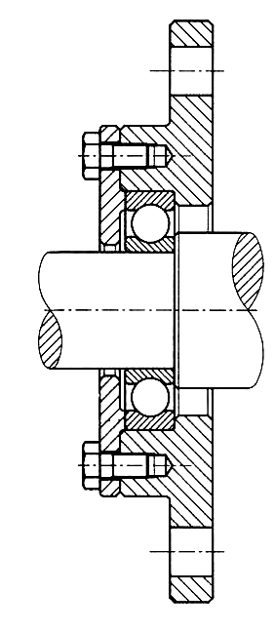
EXAMPLE 1 : Shaft support on a machine housing
Assemble steps
1. Install bearing to the shaft.
2. Install the bearing-shaft unit to
the housing.
3. Install the cover plate.
4. Tighten the screw.

Slide 46
EXAMPLE 1 : Shaft support on a machine housing
Functions of main parts
1. Bearing :
Support the rotating shaft.
2. Cover :
- Control an axial movement.
- Prevent the bearing unit from
rotation.

Slide 47
EXAMPLE 1 : Shaft support on a machine housing
Design concept
Avoid direct contact between rotating shaft and housing as well as cover plate by using a bearing and clearance holes.

Slide 48
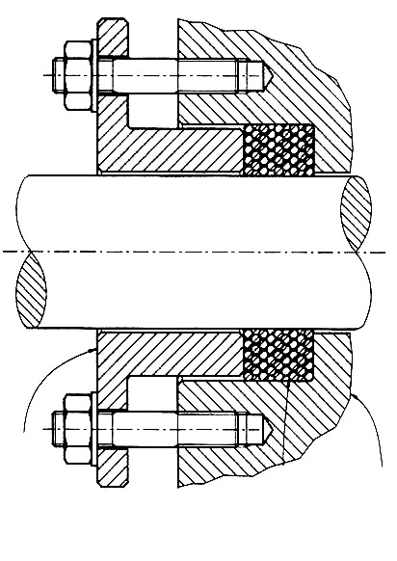
EXAMPLE 2 : Leakage prevention unit
Assemble steps
1. Wrap a packing to the shaft.
2. Install studs to the casing.
3. Install the gland ring where its
holes align with stud.
4. Place the washer and
tightening the nut.
Casing
Gland
Packing

Slide 49
EXAMPLE 2 : Leakage prevention unit
Function
1. Packing :
- Preventing the leakage of a
fluid inside the casing.
2. Gland :
- Press the packing to make it
radial expand and press the
shaft surface.
Casing
Gland
Packing

Slide 50
EXAMPLE 2 : Leakage prevention unit
Design concept
Avoid direct contact between
rotating shaft and casing as well
as gland ring’s hole.
Casing
Gland
Packing

Slide 51
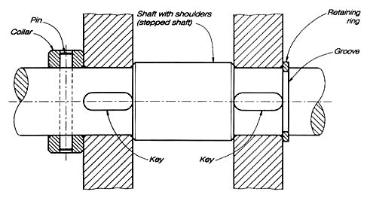
EXAMPLE 3 : Fixing parts on a shaft.
Assemble steps
1. Place the keys on the
key seats.
2. Insert the parts to the
shaft until their surfaces
lean against the shoulder.
3. Insert collar and then pin
or retaining ring into the
groove.

Slide 52
EXAMPLE 3 : Fixing parts on a shaft.
Function
1. Key :
- Preventing rotational
movement of parts.
2. Pin and retaining ring :
- Prevent axial movement
of parts on the shaft.

Slide 53
EXAMPLE : Fixing parts on a shaft.
Design concept
Retaining ring can resist
lower axial force than collar
& pin unit.

Slide 54
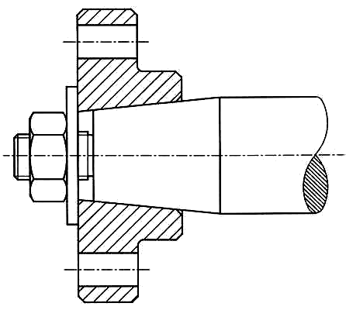
EXAMPLE : Parts with tapered holes on tapered shaft.
Assemble steps
1. Insert the part on the
tapered end of the shaft.
2. Insert the washer
(non-standard).
3. Tightening the nut.

Slide 55
EXAMPLE : Parts with tapered holes on tapered shaft.
Function
1. Washer :
- Improve the distribution
the tightening force on
the part.

Slide 56
EXAMPLE : Parts with tapered holes on tapered shaft.
Design concept
Length of the tapered
portion and depth of the
tapered hole require a
calculation.

Slide 57
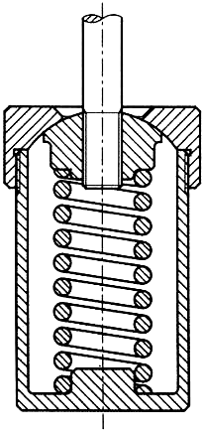
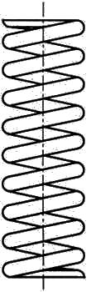
EXAMPLE : Parts having preloaded spring
Assemble steps
Spring in
free length
1. Insert the spring into the casing.
2. Tighten the rod to the spring
loader.
3. Close the cap and tighten.

Slide 58
EXAMPLE : Parts having preloaded spring
Function
1. Spring plunger :
- Transmit a force from rod to
spring.
- Keep the spring in a position.

Slide 59
EXAMPLE : Parts having preloaded spring
Design concept
Spring plunger has a spherical
surface contacts to the cap;
therefore, the rod can align itself
to original position.

Slide 60
Mating of Parts

Slide 61
POINTS TO CONSIDER
1. Surface finishing
2. Tolerance
- Size
- Geometry

Slide 62
SURFACE FINISHING
Surface finishing means the quality of a surface. It relates to the level of roughness of a surface.
Purpose
1. To control the accuracy in positioning and
tightness between mating parts.
2. To reduce the friction, especially for the part
moves relative to other parts.

Slide 63
TOLERANCE
Tolerance is the total amount dimension may vary.
It is defined as the difference between the upper and lower limits.
Purpose
1. To control an interchangeability of parts.
2. To ensures the mating part will have a
desired fit.

